Slide 1
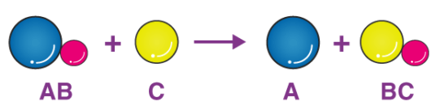
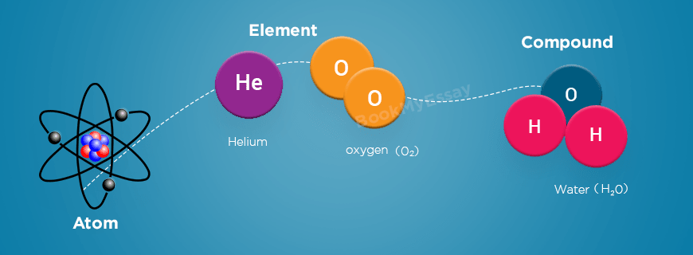
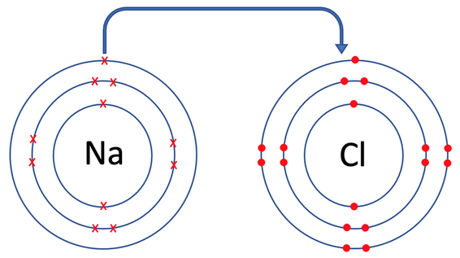
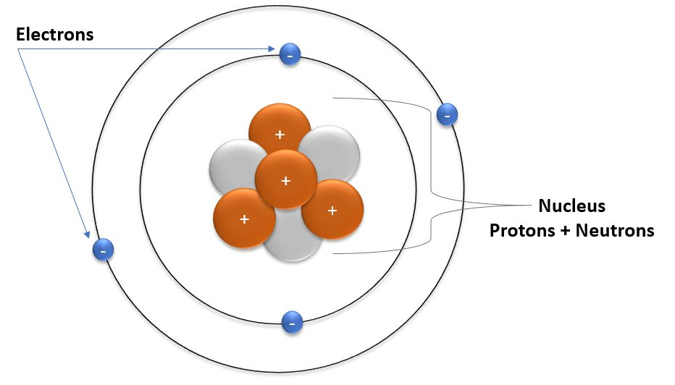
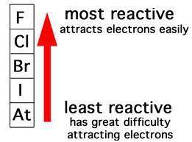


Knowledge Organiser
Year 8: Periodic Table – Atoms and Reactivity
 | Charge | Mass | Position
Protons | +1 | 1 | Nucleus
Neutrons | 0 | 1 | Nucleus
Electrons | -1 | Very small | Orbiting the nucleus
What is a displacement reaction?
The word displace means push out
A displacement reaction occurs when a more reactive element pushes out a less reactive one from its compound
What are atoms and elements?
Atoms are the simplest units of matter
If you break down a substance into the smallest bits possible, eventually you will get atoms
Elements are different types of atoms
Each element has unique chemical and physical properties
Diagram which shows the displacement of an atom from a compound during a chemical reaction
What are the properties of group 7?
The elements in group 7 of the periodic table are called the halogens
They are in the column labelled 7 at the top
They have low boiling points
Their molecules are diatomic (their atoms come in pairs)
The halogens are quite reactive compared to other elements
Diagram which compares an atom, element and compound
Using the reactivity series:
We can use the reactivity series to figure out if a displacement reaction will occur
If a metal is introduced that is more reactive it will displace the less reactive metal from its compound
Reactants | Products
magnesium + iron sulfate | magnesium sulfate + iron
zinc + silver nitrate | zinc nitrate + silver
gold + copper oxide | No reaction
copper + tin iodide | No reaction
lead + platinum chloride | lead chloride + platinum
sodium + copper phosphate | sodium phosphate + copper
What is the structure of an atom?
Atoms are made from three subatomic particles
Most of the mass of the atom is concentrated in a central nucleus
The nucleus contains the protons and neutrons
The electrons orbit the central nucleus in shells
What happens when they react?
Group 7 atoms have 7 electrons in their outer shell
When they react, they gain an electron to fill their outer shell to 8
Most atoms need to gain more than one electron to fill their outer shell
Group 7 are very reactive because it is easy to gain just one electron
Diagram which shows the structure of the atom and the position of the three subatomic particles
RAG Yourself!
Learning Outcomes; | RAG
Describe how a compound is formed from elements
Draw a labelled diagram of an atom
State the charge of the three subatomic particles
Describe the properties of elements in group 7
Describe the trend in reactivity down group 7
Explain why displacement reactions occur
A diagram which explains the trend in reactivity down group 7

Slide 2
Knowledge Organiser
Year 8: Periodic Table – Atoms and Reactivity
 | Charge | Mass | Position
Protons
Neutrons
Electrons
What is a displacement reaction?
What are atoms and elements?
Diagram which shows the displacement of an atom from a compound during a chemical reaction
What are the properties of group 7?
Diagram which compares an atom, element and compound
Using the reactivity series:
Reactants | Products
magnesium + iron sulfate
zinc + silver nitrate
gold + copper oxide
copper + tin iodide
lead + platinum chloride
sodium + copper phosphate
What is the structure of an atom?
What happens when they react?
Diagram which shows the structure of the atom and the position of the three subatomic particles
RAG Yourself!
Learning Outcomes; | RAG
Describe how a compound is formed from elements
Draw a labelled diagram of an atom
State the charge of the three subatomic particles
Describe the properties of elements in group 7
Describe the trend in reactivity down group 7
Explain why displacement reactions occur
A diagram which explains the trend in reactivity down group 7

